Slide 1
Periodic Trends

Slide 2
Objective
Objective: describe trends in ionization energy, electronegativity, atomic radius, and ions

Slide 3
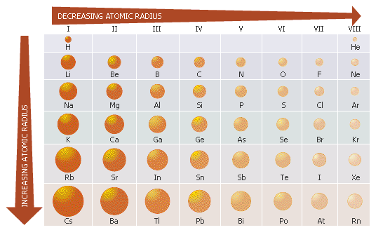
Atomic Radius Trend
Atomic radius: ½ diameter of an atom

Slide 4
Atomic Radius Trend
Period trend: radius decreases as you go left to right
Increasing # of p⁺ in energy level causes p⁺ to pull e⁻ in closer to nucleus, shrinks atom
Group trend: increase going down
e_ must go into higher orbitals = bigger atom

Slide 5
Now you try…
Use your periodic table to determine which has a larger radius:
A) K or Rb
B) B or F
C) C or Si

Slide 6
Ions
Ion: positively or negatively charged particle
Created when e⁻ are lost or gained
Positively charged ion: cation
Cations made by losing e⁻, less stuff = smaller
Metals form cations
Ex: K⁺¹ ion
Notes:
Stop and Have them Fill Out the Periodic Table Showing Charges.

Slide 7
Ions
Negatively charged ion: anion
Anions: made by gaining e⁻, more stuff = bigger
Non-metals form anions
Ex: F⁻¹

Slide 8
Now you try…
Determine which will have a smaller radius:
A) Na⁺¹ or Na
B) S⁻² or S
C) N⁻³ or N
D) Ca⁺² or Ca

Slide 9
Ionization Energy
Ionization energy: energy required to remove an e⁻ from an atom

Slide 10
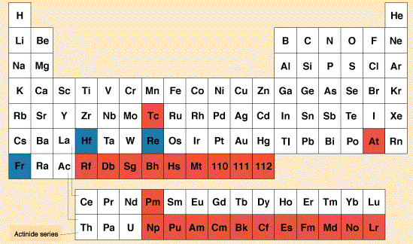
Ionization Energy Trend
Ionization Energy Increases
Ionization Energy Decreases

Slide 11
Ionization Energy Trend
Period Trend: increase left to right
more e⁻ as you move right in an energy level
More e⁻ =harder to remove
Group Trend: decrease down a group
Higher energy levels means e⁻ farther from nucleus = less energy to remove

Slide 12
Now you try…
Use your periodic table to determine which has a larger ionization energy:
A) K or Rb
B) B or F
C) C or Si

Slide 13
Electronegativity Trend
Electronegativity: ability of an element to attract e⁻ to itself

Slide 14
Electronegativity Trend
Electronegativity Increases
Electonegativity Decreases

Slide 15
Electronegativity Trend
Period trend: increase left to right
Metals lose e⁻ : low electronegativity
Non-metals gain e⁻ : high electronegativity
Group trend: decrease down a group
higher level e⁻ are farther from nucleus so weaker attraction for e⁻

Slide 16
Now you try…
Use your periodic table to determine which has a smaller electronegativity:
A) Li or Cs
B) P or Cl
C) C or F

Slide 17
Ticket Out the Door Questions
1) Which element has a larger electronegativity: Na or Cs? Why?
2) Which element has a bigger radius: Ca or Br? Why?

