Slide 1
Periodic Table and Electron Configurations

Slide 2
Objective
Objective: describe the relationship between electron configurations and an elements location on the periodic table

Slide 3
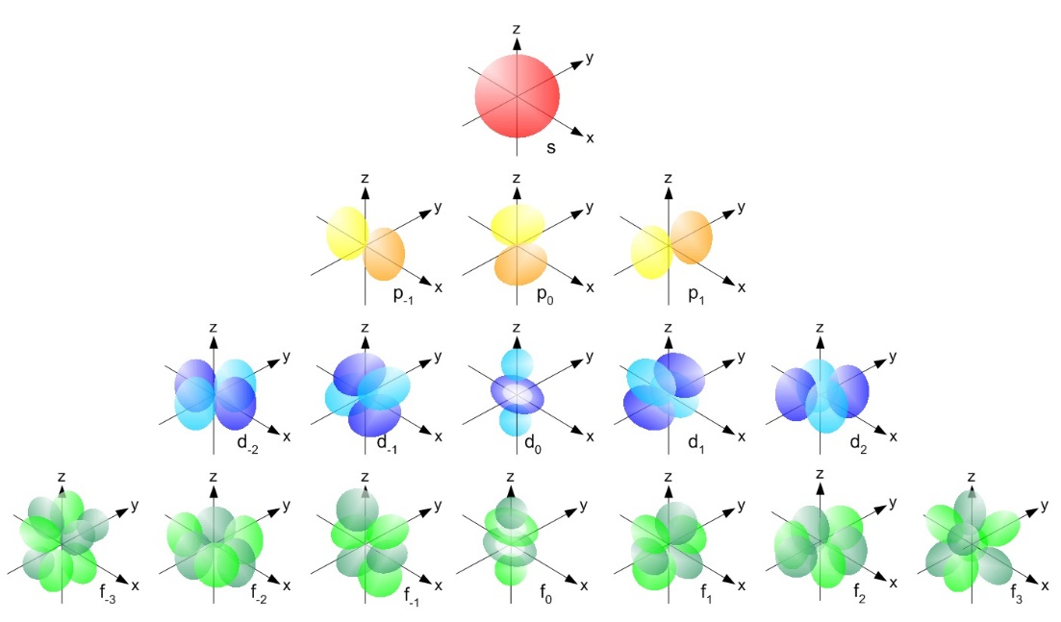
Orbitals – Sublevels for electrons
s – spherical – one orbital
p – dumbbell shaped – 3 orbitals
d – 5 orbitals – first 4 have same shape, the 5th is different
f – 7 orbitals – all different
Each orbital can hold 2 electrons

Slide 4
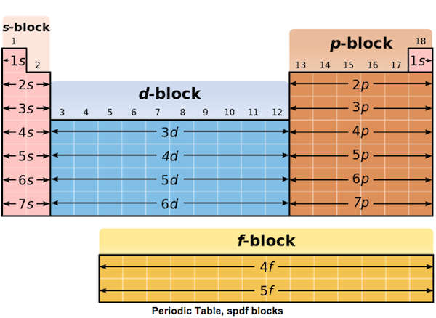
You can use the periodic table to predict the orbitals for an element.
Element’s period corresponds to # of energy levels that electrons can be found in

Slide 5
Atomic Orbitals
Electrons arrange in s, p, d, f orbitals to make stable atoms
The arrangement of the electrons in their orbitals is called e⁻ configuration
Aufbau principle: e⁻ occupy lowest energy levels first
  always start with s orbital, then p, d, and f
  Cross over starts in 3rd and 4th level

Slide 6
Periodic Table and Electron Configurations
Group 1: always ends in s¹
Ex:
  Li: 1s²2s¹ (Li: period 2)
  Na: 1s²2s²2p⁶3s¹ (Na: period 3)
  K: 1s²2s²2p⁶3s²3p⁶4s¹ (K: period 4)

Slide 7
Periodic Table and Electron Configurations
Group 2: always ends in s²
Ex:
  Be: 1s²2s² (Be: period 2)
  Mg: 1s²2s²2p⁶3s² (Mg: period 3)

Slide 8
Periodic Table and Electron Configurations
Group 13: p¹
Group 14: p²
Group 15: p³
Group 16: p⁴
Group 17: p⁵

Slide 9
Periodic Table and Electron Configurations
Group 18: full s and p orbital (except He, it only has 2 e⁻ so its full shell includes only 1s)
  Makes them unreactive
s orbital e⁻ + p orbital e⁻ = # valence e⁻

Slide 10
Transition Metals
Transition metals: all e⁻ config end in d
Inner transition metals (lanthanides and actinides): all e⁻ config. end in f

Slide 11
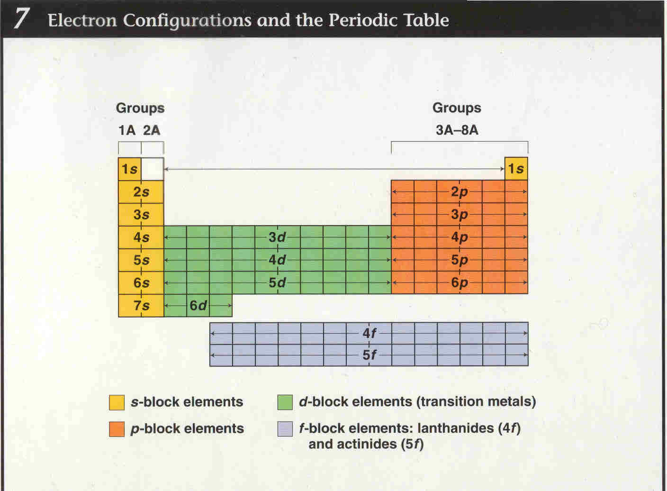
Notes:
Show electron configuration using the periodic table You Tube video

Slide 12
Now you try…
Using your periodic table, write down what the ending electron configuration for each element will be according to its location on the periodic table (answers on next slide).
A) Ba
B) I
C) Cs

Slide 13
ANSWERS!
A) Ba → 6s²
B) I → 5p⁵
C) Cs → 6s¹

Slide 14
8s
7s 7p
6s 6p 6d
5s 5p 5d 5f
4s 4p 4d 4f
3s 3p 3d
2s 2p
1s
Electron Configurations – In what
order are the orbitals filled?

Slide 15
1s
8s
7s 7p
6s 6p 6d
5s 5p 5d 5f
4s 4p 4d 4f
3s 3p 3d
2s 2p
1s
2s
2p
3s
3p
4s
3d
4p
5s
4d
5p
6s
4f
5d
6p
7s
6d
7p
8s
5f

Slide 16
8s
7s 7p
6s 6p 6d
5s 5p 5d 5f
4s 4p 4d 4f
3s 3p 3d
2s 2p
1s
1s 2s 2p 3s 3p 4s 3d 4p 5s 4d 5p 6s 4f 5d 6p 7s 5f 6d 7p 8s

Slide 17
8s
7s 7p
6s 6p 6d
5s 5p 5d 5f
4s 4p 4d 4f
3s 3p 3d
2s 2p
1s
Follow the arrows to create an electron configuration.
Each arrow represents a step.

Slide 18
8s
7s 7p
6s 6p 6d
5s 5p 5d 5f
4s 4p 4d 4f
3s 3p 3d
2s 2p
1s
Sample electron configuration Problems:
The first arrow passes through 1s. An s orbital only has one level, so the first arrow gives 2 electrons and 2 elements. Each new electron means a new element.
Hydrogen =1 electron 1s¹
Helium = 2 electrons 1s²

Slide 19
8s
7s 7p
6s 6p 6d
5s 5p 5d 5f
4s 4p 4d 4f
3s 3p 3d
2s 2p
1s
The second arrow passes through 2s. An s orbital only has one level, so the second arrow adds 2 electrons and 2 elements. Each new electron means a new element.
Lithium = 3 electrons = 1s² 2s¹
Beryllium = 4 electrons = 1s² 2s²

Slide 20
8s
7s 7p
6s 6p 6d
5s 5p 5d 5f
4s 4p 4d 4f
3s 3p 3d
2s 2p
1s
The third arrow passes through 2p and 3s. A p orbital has 3 level, and an s orbital has 1 level so the third arrow adds 8 electrons and 8 elements. Each new electron means a new element.
Boron = 5 electrons 1s² 2s² 2p¹
Magnesium =1s² 2s² 2p⁶ 3s² (12 total electrons)

Slide 21
8s
7s 7p
6s 6p 6d
5s 5p 5d 5f
4s 4p 4d 4f
3s 3p 3d
2s 2p
1s
The fourth arrow passes through 3p and 4s. A p orbital has 3 level, and an s orbital has 1 level so the fourth arrow adds 8 electrons and 8 elements. Each new electron means a new element.
Aluminum: 1s²2s²2p⁶3s²3p¹
Calcium 1s² 2s² 2p⁶ 3s² 3p⁶ 4s²

Slide 22
Give the electron configuration for C, N, F, Na.
Carbon = 6 electrons 1s² 2s² 2p²
Nitrogen = 7 electrons 1s² 2s² 2p³
Fluorine = 9 electrons 1s² 2s² 2p⁵
Sodium = 11 electrons 1s² 2s² 2p⁶ 3s¹

Slide 23
Give the electron configuration for Fe, Zn, Br, Sr.
Iron = 26 electrons 1s² 2s² 2p⁶ 3s² 3p⁶ 4s² 3d⁶
Zinc= 30 electrons 1s² 2s² 2p⁶ 3s² 3p⁶ 4s² 3d¹⁰
Bromine = 35 electron 1s² 2s² 2p⁶ 3s² 3p⁶ 4s² 3d¹⁰ 4p⁵
Strontium= 38 electrons 1s² 2s² 2p⁶ 3s² 3p⁶ 4s² 3d¹⁰ 4p⁶5s²

Slide 24
Now you try…
Using your periodic table, write the electron configuration for each element according to its location on the periodic table (answers on the next slide).
A) F
B) Si
C) Zn
Notes:
F = 1s²2s²2p⁵
Si = 1s²2s²2p⁶3s²3p⁶
Zn = 1s²2s²2p⁶3s²3p⁶ 4s²3d¹⁰
^{Watch Video}

Slide 25
Answers!
A) F → 1s² 2s² 2p⁵
B) Si → 1s² 2s² 2p⁶ 3s² 3p²
C) Zn → 1s² 2s² 2p⁶ 3s² 3p⁶ 4s² 3d¹⁰

Slide 26
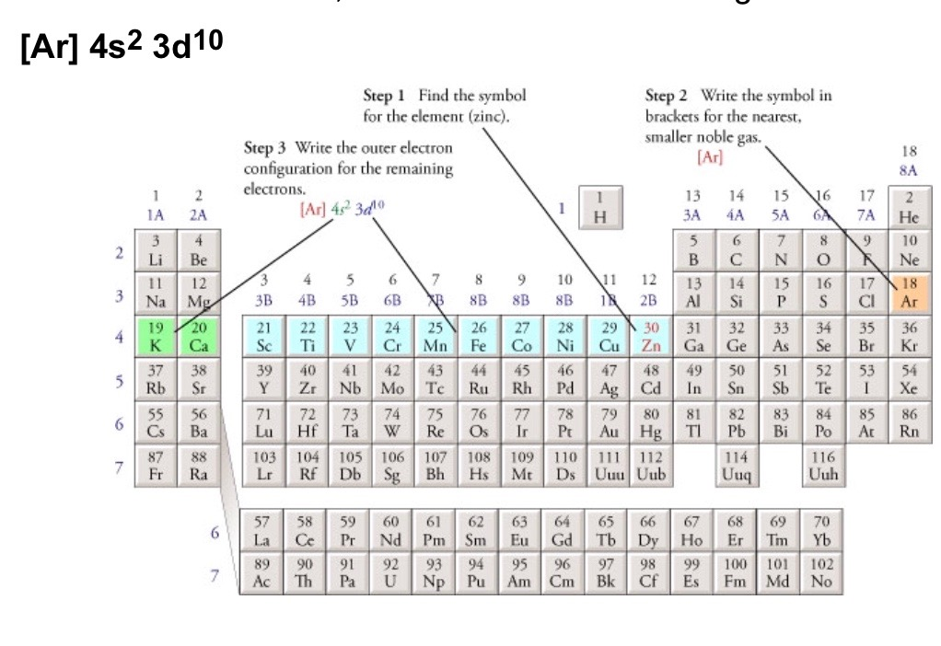
Abbreviated (noble gas or short-hand configurations)
Find the symbol for the element on the periodic table
Write the symbol in brackets for the noble gas located at the far right of the preceding horizontal row on the table
Move back down a row and to the far left. Following the elements in the row write the outer –electron configuration associated with each column until you reach the element you are describing.

Slide 27

Examples…
Oxygen
  Noble gas configuration [He] 2s² 2p⁴
Zinc (30) 1s² 2s² 2p⁶ 3s² 3p⁶ 4s² 3d¹⁰
  Noble gas configuration [Ar] 4s² 3d¹⁰

Slide 28
Now you try
(answers on next slide)
Write the noble gas configuration for Cesium (55)
Write the noble gas configuration for Gold (79)
Write the noble gas configuration for Antimony (51)

Slide 29
ANSWERS!
Noble gas configuration for Cs
  [Xe] 6s¹
Noble gas configuration for Au
  [Xe] 6s²5d⁹
Noble gas configuration for Antimony
  [Kr]5s²4d¹⁰5p³

