Slide 1
Electron Configurations

Slide 2
Objective
Objective: use the Aufbau principle, Hund’s rule, and the Pauli exclusion principle to write electron configurations

Slide 3
Review: Atomic Orbitals
Electrons arrange in s, p, d, f orbitals to make stable atoms
The arrangement of the electrons in their orbitals is called e⁻ configuration
Aufbau principle: e⁻ occupy lowest energy levels first
always start with s orbital, then p, d, and f
Cross over starts in 3rd and 4th level

Slide 4
8s
7s 7p
6s 6p 6d
5s 5p 5d 5f
4s 4p 4d 4f
3s 3p 3d
2s 2p
1s
Remember the order that the orbitals are filled!!
1s 2s 2p 3s 3p 4s 3d 4p 5s 4d 5p 6s 4f 5d 6p 7s 5f 6d 7p 8s

Slide 5
Atomic Orbitals
Aufbau principle: e⁻ occupy lowest energy levels first
always start with s orbital, then p, d, and f
Cross over starts in 3rd and 4th level
Pauli exclusion principle: full orbital contains 2 e⁻
One e⁻ spins clockwise (↑), other spins counterclockwise (↓)
Full orbital: ↑↓
Hund’s rule: all e⁻ will be unpaired before they pair up

Slide 6
Now you try…
Write what the Aufbau principle, Pauli exclusion principle, and Hund’s rule say in your own words.

Slide 7
Writing Electron Configurations
using Orbital Notation
s²
s holds a maximum of 2 electrons
s _____

Slide 8
Orbital Configurations
p holds a maximum of 6 electrons
p⁶
p _____ _____ _____

Slide 9
Orbital Configurations
p holds a maximum of 6 electrons
p³
p _____ _____ _____

Slide 10
Orbital Configurations
p holds a maximum of 6 electrons
p⁵
p _____ _____ _____

Slide 11
Orbital Configurations
d holds a maximum of 10 electrons
d¹⁰
d _____ _____ _____ _____ _____

Slide 12
Orbital Configurations
d holds a maximum of 10 electrons
d⁶
d _____ _____ _____ _____ _____

Slide 13
Orbital Configurations
f holds a maximum of 14 electrons
f¹⁴
f ____ ____ ____ ____ ____ ____ ____

Slide 14
Now you try! (answers on the next slide)
1) Write the orbital notation (arrows) for P.
2) What element is this?

Slide 15
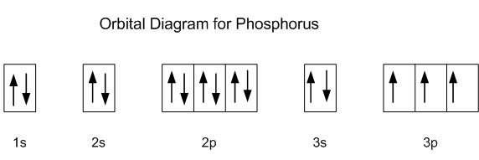
ANSWERS!
Write the orbital notation (arrows) for P.
2) What element is this?
Barium (Ba)

