Slide 1
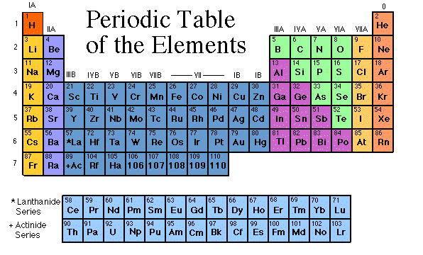
Periodic Table of Elements

Slide 4
Properties of Metals
Metals are good conductors of heat and electricity.
Metals are shiny.
Metals are ductile (can be stretched into thin wires).
Metals are malleable (can be pounded into thin sheets).

Slide 5
Properties of Non-Metals
Non-metals are poor conductors of heat and electricity.
Non-metals are not ductile or malleable.
Solid non-metals are brittle and break easily.
They are dull.
Many non-metals are gases.
Sulfur

Slide 6
Properties of Metalloids
Metalloids (metal-like) have properties of both metals and non-metals.
Silicon

Slide 7
Families

Slide 19
Hydrogen
The hydrogen square sits atop Family 1A, but it is not a member of that family. Hydrogen is in a class of its own.
It’s a gas at room temperature.
It has one proton and one electron in its one and only energy level.

Slide 20
Alkali Metals
The alkali family is found in the first column of the periodic table.

Slide 21
Alkali Metals
They are the most reactive metals.
They react violently with water.
Alkali metals are never found as free elements in nature. They are always bonded with another element.

Slide 22
Alkaline Earth Metals
They are never found uncombined in nature.

Slide 23
Transition Metals
Transition Elements include those elements in the B families.
They are good conductors of heat and electricity.

Slide 24
Boron Family
The Boron Family is named after the first element in the family.

Slide 25
Carbon Family
Atoms of this family have 4 valence electrons.
This family includes a non-metal (carbon), metalloids, and metals.
The element carbon is called the “basis of life.” There is an entire branch of chemistry devoted to carbon compounds called organic chemistry.

Slide 26
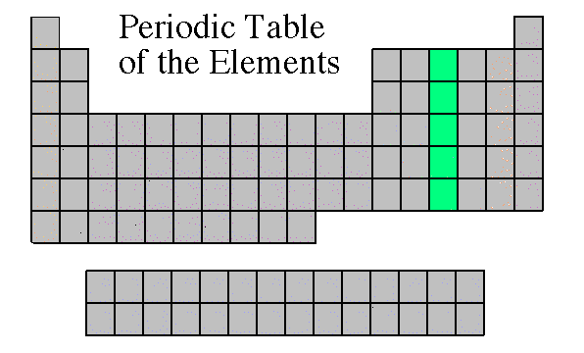
Nitrogen Family
The nitrogen family is named after the element that makes up 78% of our atmosphere.
This family includes non-metals, metalloids, and metals.
Atoms in the nitrogen family have 5 valence electrons. They tend to share electrons when they bond.
Other elements in this family are phosphorus, arsenic, antimony, and bismuth.

Slide 27
Oxygen Family
Atoms of this family have 6 valence electrons.
Most elements in this family share electrons when forming compounds.
Oxygen is the most abundant element in the earth’s crust. It is extremely active and combines with almost all elements.

Slide 28
Halogen Family
They are the most active non-metals. They are never found free in nature.

Slide 29
Noble Gases
Noble Gases are colorless gases that are extremely un-reactive.

Slide 30
Rare Earth Elements
The thirty rare earth elements are composed of the lanthanide and actinide series.
One element of the lanthanide series and most of the elements in the actinide series are called trans-uranium, which means synthetic or man-made.

