Slide 1
Rulers Rules
Notes:
Image is from: http://upload.wikimedia.org/wikipedia/commons/5/5d/Righello.jpg

Slide 2
Rule #1
All measurements require Units!

Slide 3
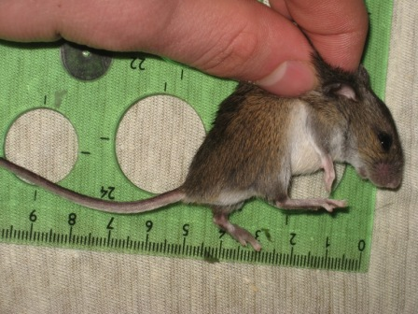
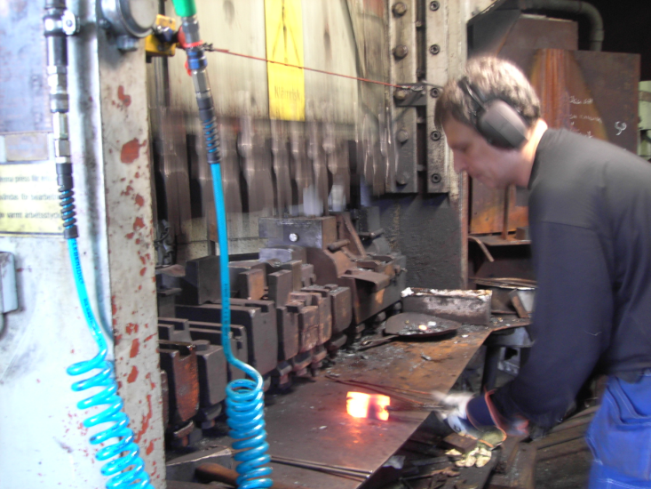
Almost ALL scientific investigations require a measurement.
Measurements are made from instruments.
Instruments are made from people.
As a result, there is uncertainty in our measurements.
Also, there is a limit to the precision in the instrument.
Notes:
Image of mouse is from: http://commons.wikimedia.org/wiki/Category:Measuring#mediaviewer/File:Apodemus_uralensis_(measuring_1).jpg
Image of man in shop: http://commons.wikimedia.org/wiki/File:Production_of_a_modern_axe_2005.jpg

Slide 4
Rule #2
You can only estimate ONE digit!

Slide 5
How to properly record a measurement
using an instrument
This example will use a simple metric ruler.
Length = 3
.3
cm
Certain
digit
Estimated
digit
Notes:
Script: (Click mouse) Lets walk through an example of how measure the longest side of a rectangular prism with a simple metric ruler. (click mouse) Line the edge of the rectangular prism on the line marked zero. It is clear that the measurement is more than 3 centimeters but less than 3.5 cm. (click mouse) It will now be necessary to estimate the value for the tenth place. It appears to be a little more than halfway, so lets estimate 3 tenths. (click mouse) Once a value has been estimated, the measurement must stop there. Only one estimated value is allowed. In addition, all measurements need to include a unit. (click mouse) This measurement reads 3.3 cm. It is important to note that the measurement has one certain value and one estimated value. Measurements can have many certain values but only one estimated value. (click mouse)

Slide 6
Another example
230
210
Meniscus
.9
mL
217
Certain
Values
Estimated
Value
Notes:
These same rule apply to all instruments. Next lets measure the volume of water in this graduated cylinder. In order to do this a close up view is necessary. (click mouse) An important thing to notice is that the water is not level. It actually has a small curved dip. This curve is known as the meniscus. (click mouse) When reading a graduated cylinder, the measurement should be made from the bottom of the meniscus. It appears that the volume of the water is just below the 214 ml line. So the volume is somewhere between 213 and 214 ml. The certain values on this measurement would be 213. (click mouse) Now lets determine the estimated value. Since the water is very close to the top line the estimated value makes sense to be point 9. (click mouse) And remember to not forget the unit. (click mouse) It would have been very tempting to estimate the value behind the decimal to be point 95. But recall, there can only be one estimated value.

Slide 7
Rule 3
When making calculations with measurements your result cannot be more precise than the measurement!

Slide 8
Using measurements in calculations
Length = 3
.3
cm
Width = 1
.2
cm
Certain
digit
Estimated
digit
Certain
digit
Estimated
digit
Notes:
Lets measure the length and width of this blue rectangular prism. A valid measurement here would be 3.3 cm. (click mouse) Lets measure the width of the face of the rectangular prism.(Click mouse) An acceptable measurement for the width would be 1.2 cm(click mouse)

Slide 9
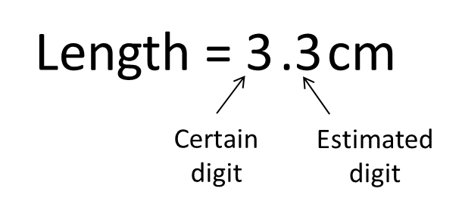
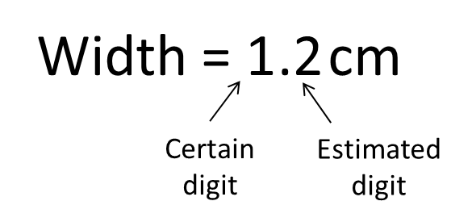
Area = (length) (width)
= (3.3 cm)(1.2 cm)
= 3.96 cm²
There are 2 digits in each measurement.
Final answer in proper number of digits:
4.0 cm²
Notes:
If the area of the shaded rectangle was calculated the result would be 3.96 square centimeters. (click mouse) Notice that there are two digits in each measurement. (click mouse) The issue with this result is that it is more precise than the measurement instrument used. To correct for this, the number of digits in the final calculation must be consistent with the smallest number of digits used. So it is necessary to round this value to two digits. (click mouse) The result is 4.0 square centimeters. This value is acceptable as it is consistent with the limit of the precision of the instrument.

Slide 10
Re – Measure the Blue rectangular prism with the rulers and compare to your original measurements.
Ruler | Length | Width | Height | Area | Volume
Pink | 3 Nu | 1 Nu | 1Nu | 3 Nu² | 3 Nu³
Orange | 2.8 Nu | 0.9 Nu | 0.6 Nu | 2.5 Nu² | 1.5 Nu³
Green | 2.83 Nu | 0.90 Nu | 0.59 Nu | 2.55 Nu² | 1.50 Nu³
Notes:
(Now ask students to re-measure the blue cube and compare to their original measurements after hearing the rules.) (Click mouse to show results of blue measured cube.)

